Slide 1
Energy-Ecology Domain Collaboration
May 11th, 2020

Slide 2
GBIF (Global Biodiversity Information Facility)
International collection of occurrence data for a wide range of taxa
Taxa of interest: rodents and raptors (potentially woodpeckers and urban birds i.e., starlings)
Open source
Data is a collection of standardized and compiled data sources
Sources vary by collection method, availability, and reporting methods
Potential caveats
Data structure variables available to adjust for detection and sampling bias (ebird)

Slide 3
Data Sources
eBird – Semi structured citizen science database for international bird occurrences. Standardized collection methods, species checklists, include fields in data that allow the user to account for spatial, temporal, observer, and species detection bias.
iNaturalist Research Grade– Online social network for sharing biodiversity information. An observation is considered “Research Grade” when it has a photo, date, and coordinates. The community must have a majority vote agreeing on the taxa identification.
NatureServe – Vouchered specimen records of endangered or threatened species for Natural Heritage Programs in the US and Canada. Geographic information kept non-sensitive.

Slide 4
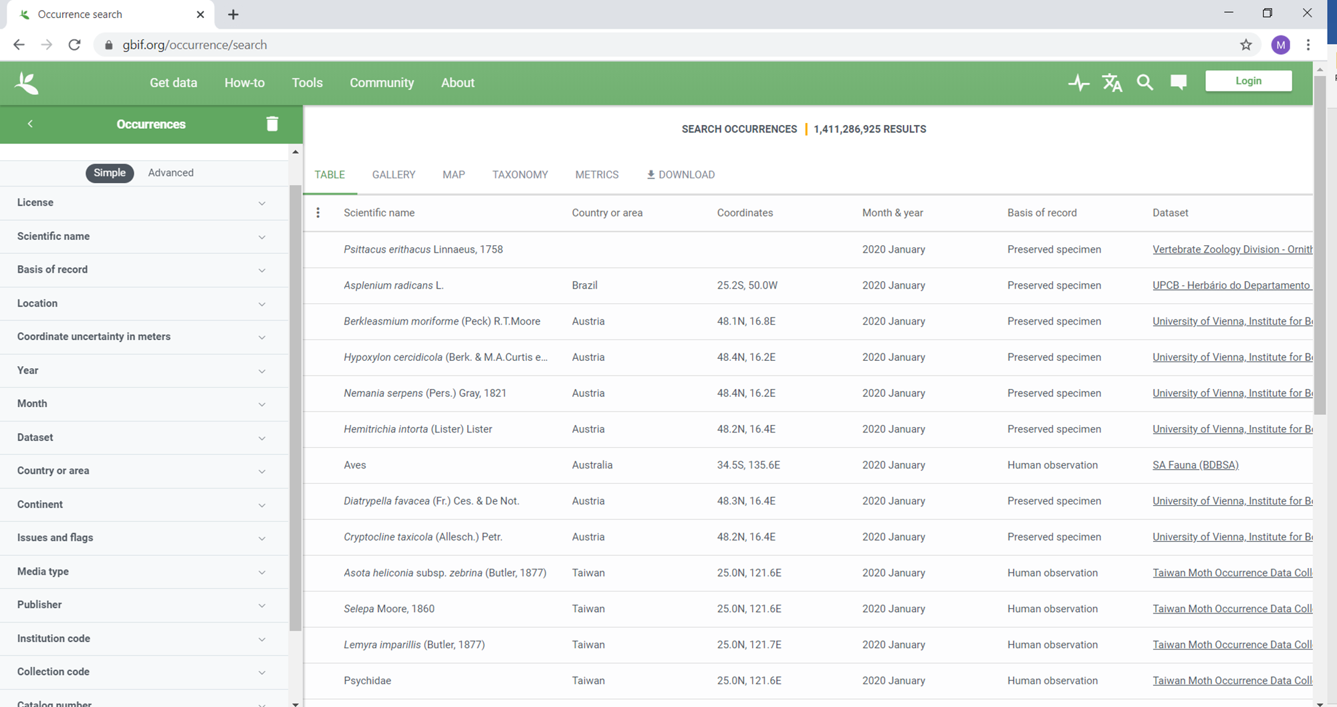

Slide 5
GBIF Information
Field Name | Definition
decimalLatitude | Latitude
decimalLongitude | Longitude
coordinateUncertaintyInMeters | Coordinate uncertainty in meters
Order | Taxonomic order
Family | Taxomonic family
Genus | Taxonomic genus
Subgenus | Taxonomic sub-genus
specificEpithet | Taxonomic species
infraspecificEpithet | Taxonomic sub-species
taxonRank | The taxonomic level that the species was identified to (order, family, genus, species, subspecies)
Elevation | Elevation above sea-level that the observation was made
Issue | Notes on any assumptions or adjustments made to the occurrence when incorporating it into the database. (Mostly spatial adjustments).
hasCoordinate | 1- has lat long coordinate data; 0- does not have lat long coordinate data
hasGeospatialIssues | 1 -Geospatial issues associated with the record may increase uncertainty; 0- no geospatial issues.
orderKey | Unique numerical ID associated with the species’ taxonomic order
familyKey | Unique numerical ID associated with the species’ taxonomic family
genusKey | Unique numerical ID associated with the species’ taxonomic genus
speciesKey | Unique numerical ID associated with the species’ taxonomic species
species | Scientific name
duplicate | Indicates record is a duplicate observation, 0- indicates record is a unique observation
hasTIme | Indicates record has temporal resolution to minutes, 0- record does not have a temporal resolution past date
individualCount | abundance/number of individuals observed; only consistently available with eBird associated records
Field Name | Definition
gbifID | Unique identifier for the record in the GBIF database
Publisher | Organization that provided the data record (source database owner).
References | Direction to original observation from the source database (combination of “identifier” and “references” fields)
institutionCode | Unique code for the source database organization.
datasetName | Source database name
basisOfRecord | Method of observation/documentation of the species
informationWithheld | Any information withheld about the observation (often for legal protection of a species)
OccurrenceRemarks | Observation notes
East_time | Time the species was observed (24 hr Eastern Time, adjusts standard or daily depending on time of year) (Combination of “verbatimEventDateD” and “eventTime” fields)
UTC_Time | Time the species was observed (24 hr coordinated universal time) (Combination of “verbatimEventDate” and “eventTime” fields)
Date | Date the observation was made (YYY-MM_DD)
Year | Year the observation was made
Month | Month the observation was made
Day | Day the observation was made
countryCode | Country the observation was made
County | County the observation was made
Locality | Fine details on observation location. Varies from townships, street names, to property names. (Combination of “locality” and “verbatimLocality” fields)

Slide 6
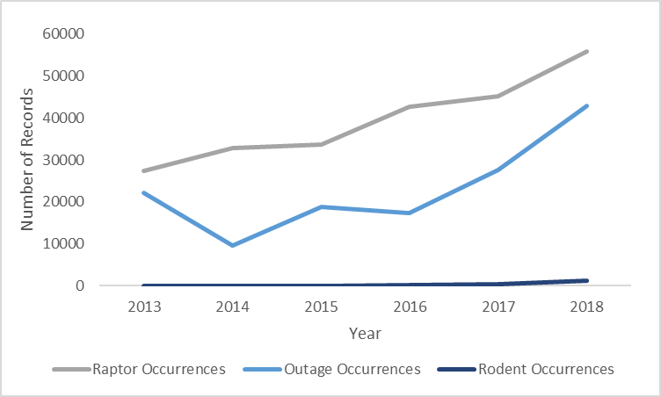
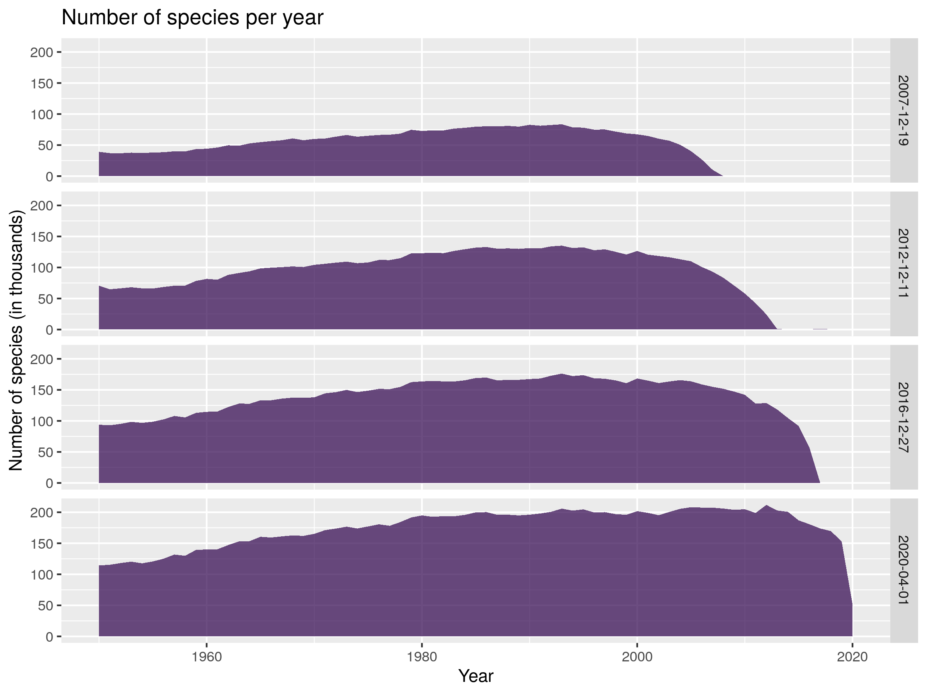
Record Availability
Data collection has grown in recent years
Citizen science becoming more prevalent
GBIF is still expanding their database
Trends in richness and abundance is biased by changes in data collection
Year | Raptor Occurrences | Outage Occurrences | Rodent Occurrences
2013 | 27346 | 22147 | 46
2014 | 32749 | 9511 | 83
2015 | 33736 | 18739 | 77
2016 | 42698 | 17340 | 206
2017 | 45106 | 27521 | 409
2018 | 55878 | 42895 | 1312

Slide 7
Data Sources
iNaturalist has time stamp (hh:mm:ss) temporal resolution; remaining records at day or month resolution.
Ebird and iNaturalist have lat/long spatial resolution; remaining records at town or county resolution.
Raptors:
Ebird 99.7%, iNaturalist 0.28%, NatureServe 0.02%
~3% of records with temporal resolution at hh:mm:ss
~74% of records spatially joined with MA towns, ~35% with streets
Rodents:
iNaturalist 100%
~95% of records with temporal resolution at hh:mm:ss
~99.5% of records spatially joined with MA towns, ~24.5% with streets

Slide 8
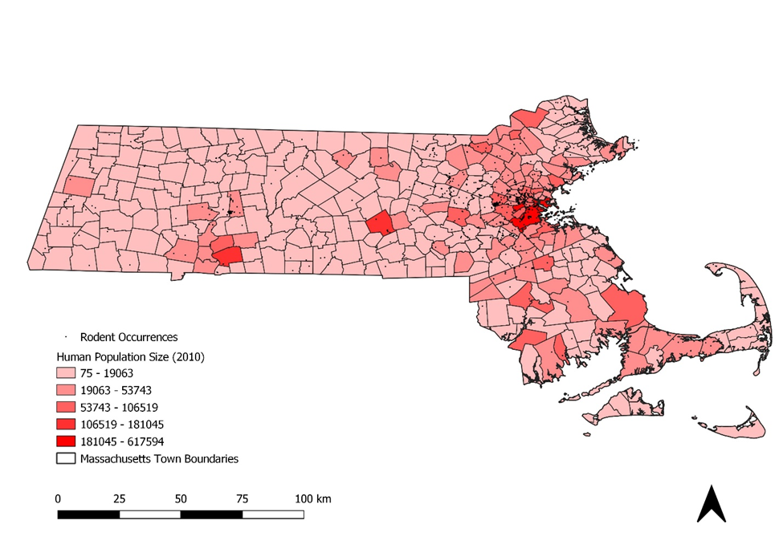
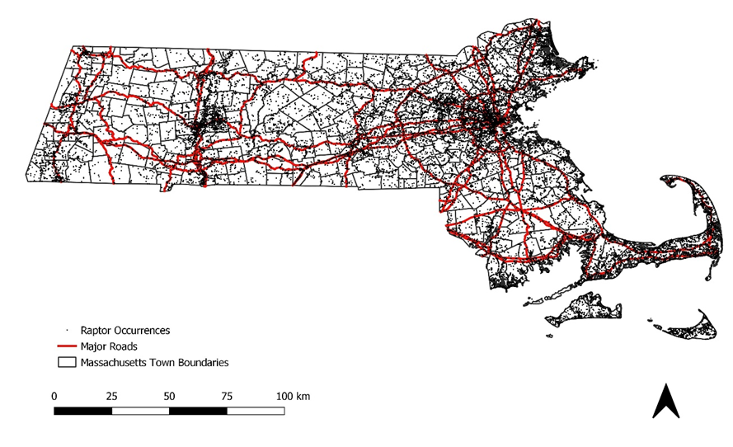
Data Sources: Bias
Citizen science data biases:
Inferred absences
Spatial bias-distribution of survey sites (easy access)
Observational bias- variance in number of volunteers available (population size), taxonomic preference
Detection bias- Observer abilities, species, season, habitat, weather, time of day, number of observers.
Temporal bias- schedule availability of observers (weekends)
eBird has fields available that sort by inferred absences, survey duration, start time, distance traveled, and number of observers. Reduces detection bias.

Slide 9
Data Sources: Bias
Adjusting for temporal or spatial bias in citizen science data
Reduce spatial scale- scale up to larger spatial units or sample within a grid.
Reduce temporal scale- summarize data week to week, month to month, or summarize by a single season to compare across years.

Slide 10
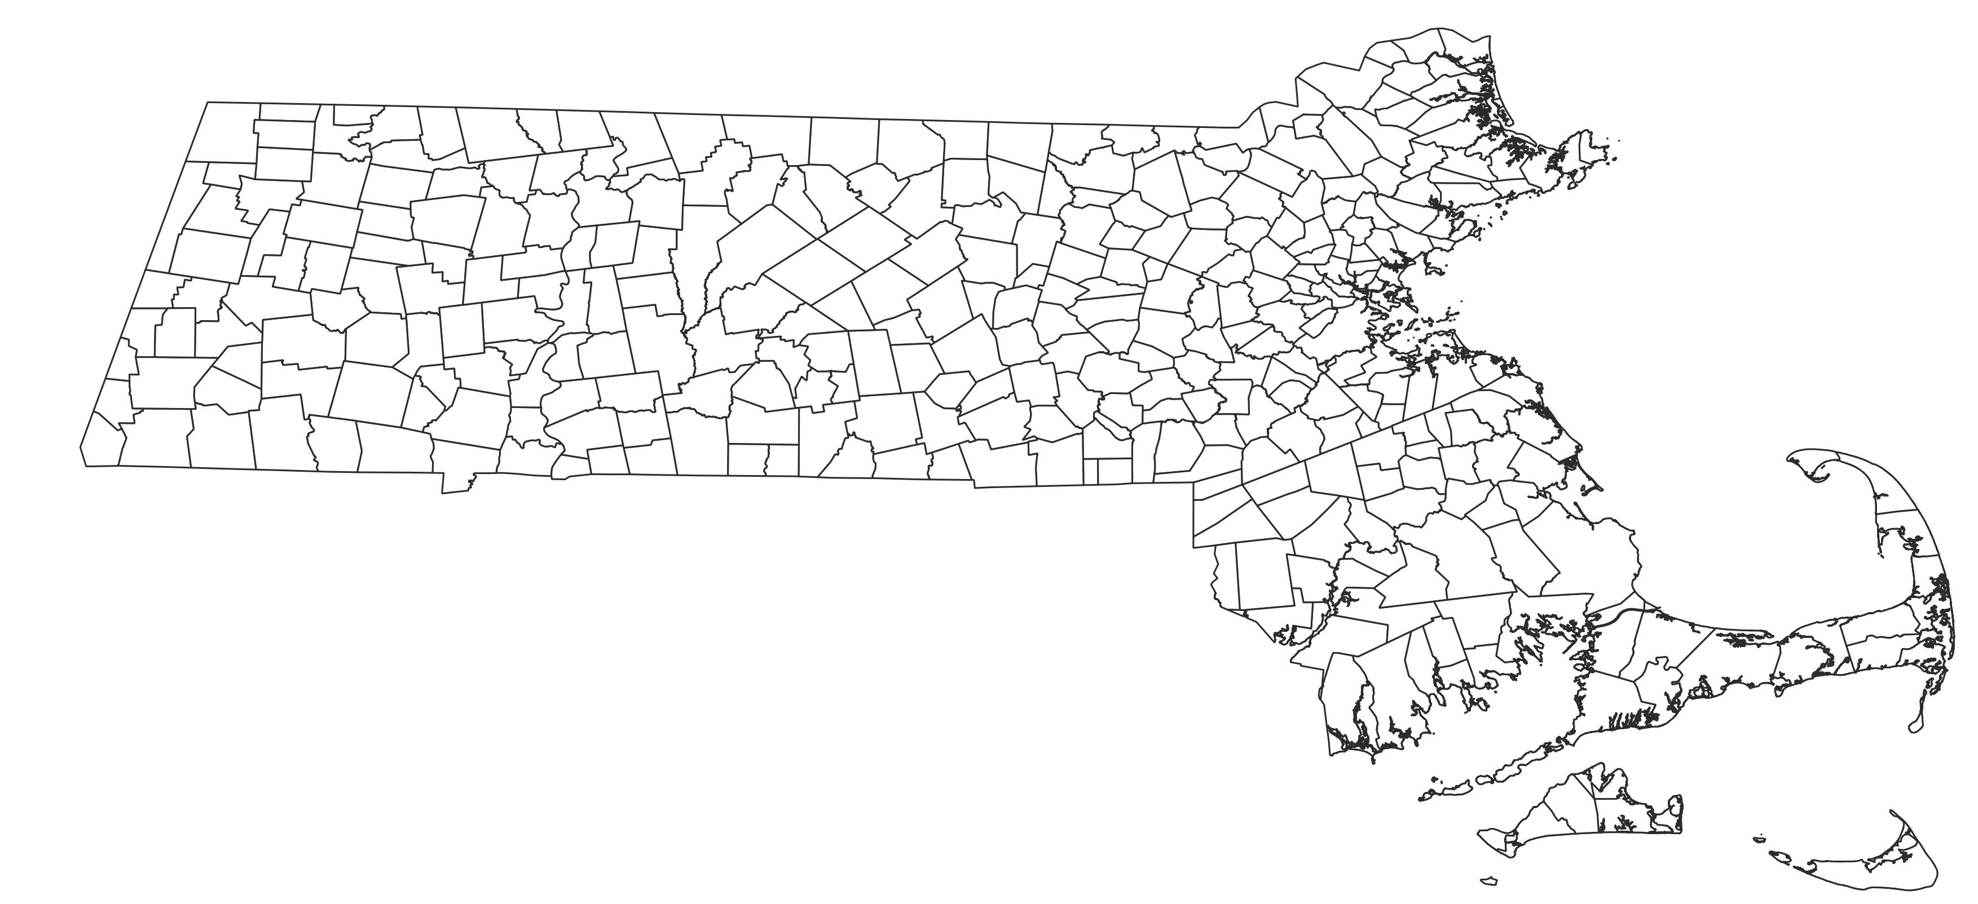
Temporal and Spatial Scale Units
Spatial resolution: Massachusetts town boundaries
Temporal resolution: Year (comparable by season), month, within year seasons, time of day
Observational data can be biased by time of day or day of week, suggest using at least week resolution data.

Slide 11
Spatial Referencing
Not all MA towns had outage data. Towns were added to outage data with empty (NA) records to cover the entire state.
Towns missing from the outage data were added and given unique IDs.
Animal occurrences were spatially joined to each town’s unique ID.
Town Names Added
BELMONT
BERKLEY
BOYLSTON
BRAINTREE
DANVERS
HOLDEN
HUDSON
HULL
IPSWICH
LYNNFIELD
MANSFIELD
MARBLEHEAD
MERRIMAC
NORTH ATTLEBOROUGH
NORTH READING
OAKHAM
PAXTON
PEABODY
PRINCETON
RAYNHAM
ROWLEY
SHREWSBURY
SOUTH HADLEY
TAUNTON
TEMPLETON
WAKEFIELD
WELLESLEY
WEST BOYLSTON
GROTON
GOSNOLD
GEORGETOWN
NEW BRAINTREE
MIDDLETON
BOXBOROUGH
LITTLETON
Town name edits. Outage data included names that classified as neighborhoods. These were translated to the city/town each neighborhood is a part of. Some town names no longer existed in state records and some city names were abbreviated.
Outage Data Town Name | Adjusted Town Name
BOSTON DOWNTOWN | BOSTON
BOURNE PLYMOUTH | BOURNE
BRIGHTON | BOSTON
CHARLESTOWN | BOSTON
DORCHESTER | BOSTON
E. BRIDGEWATER | EAST BRIDGEWATER
EAST BOSTON | BOSTON
ENFIELD | BOSTON
EPSOM | HAMPDEN
HYANNIS | BARNSTABLE
HYDE PARK | BOSTON
MT. WASHINGTON | MOUNT WASHINGTON
NEW MARLBORO | NEW MARLBOROUGH
NORTH TISBURY | WEST TISBURY
ROXBURY | BOSTON
SANDWICH PLYMOUTH | SANDWICH
SOUTH BOSTON | BOSTON
WEST ROXBURY | BOSTON

Slide 12
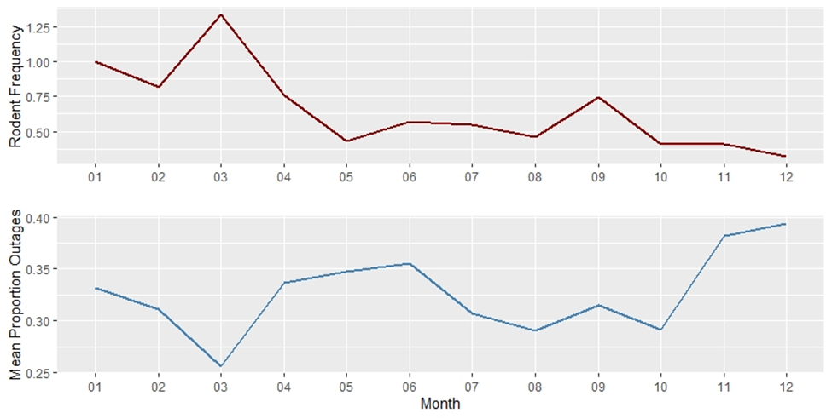
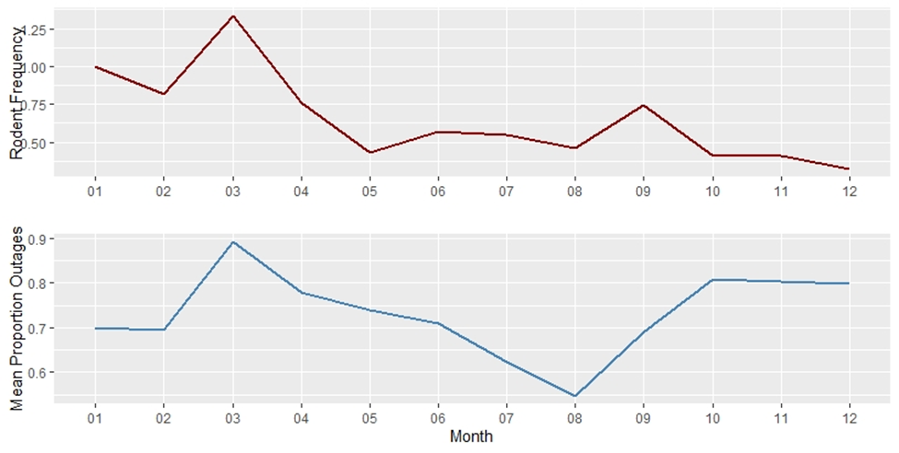
Summarizing and Standardizing the Data
Time Series (2013-2018)
Monthly
Daily
Time of Day (Day or Night)
Monthly rodent frequency weighted by number of observers (top) and the proportion of animal caused outages out of total outages (bottom) averaged across towns statewide during 2018.
Monthly rodent frequency weighted by number of observers (top) and the proportion of outages with animal related causes out of total outages (bottom) averaged across towns statewide during 2018.

Slide 13
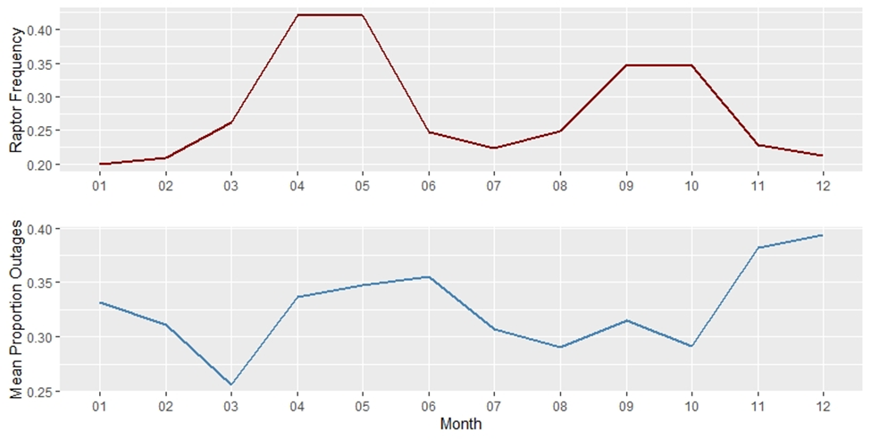
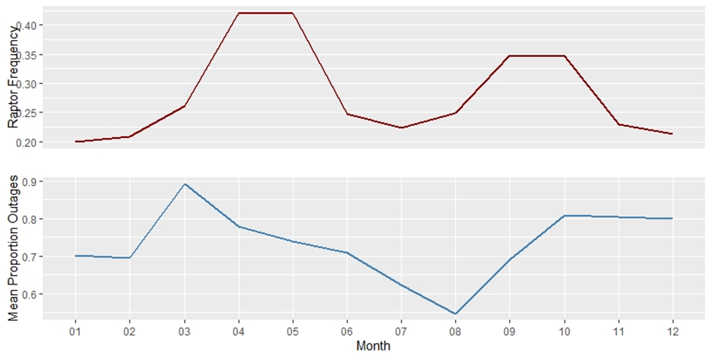
Summarizing and Standardizing the Data
Time Series (2013-2018)
Monthly
Daily
Time of Day (Day or Night)
Monthly raptor frequency weighted by number of observers (top) and the proportion of animal caused outages out of total outages (bottom) averaged across towns statewide during 2018.
Monthly raptor frequency weighted by number of observers (top) and the proportion of outages with animal related causes out of total outages (bottom) averaged across towns statewide during 2018.

Slide 14
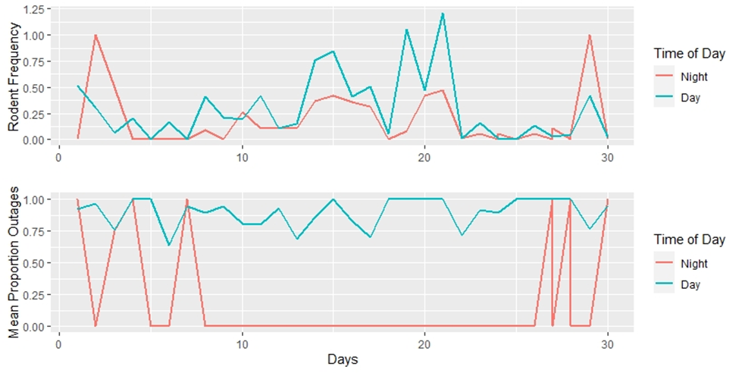
Summarizing and Standardizing the Data
Time Series (2013-2018)
Monthly
Daily
Time of Day (Day or Night)
Daily and nightly rodent frequency weighted by number of observers (top) and the proportion of outages with animal related causes out of total outages (bottom) averaged across towns statewide during September 2018.

Slide 15
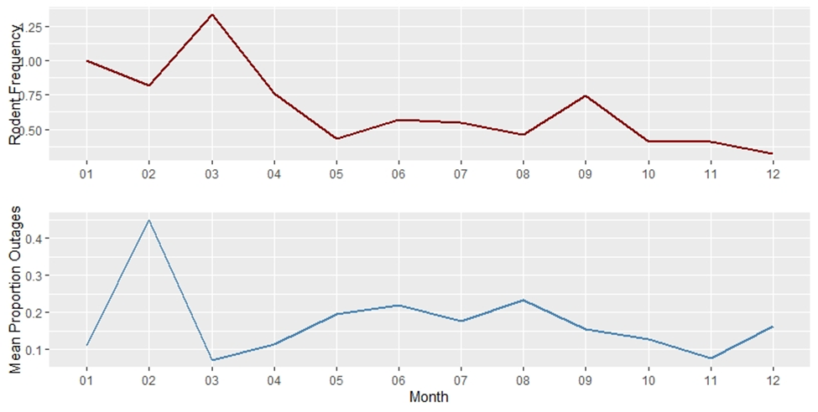
Summarizing and Standardizing the Data
Time Series (2013-2018)
Monthly
Daily
Time of Day (Day or Night)
Monthly rodent frequency weighted by number of observers (top) and the proportion of squirrel caused outages out of total outages (bottom) averaged across towns statewide during 2018.

Slide 16
Summarizing and Standardizing the Data
Summary Fields (Within each town during the specified unit of time (month, day, time of day):
For outages
Proportion of Town Outages- number of outages from a specified cause out of the total outages in the town (outages of a specific reason cause/ all outages).
Proportion of State Outages-The proportion of outages from a specific cause in the town out of the total number of outages from that cause across the state (outages with reason cause in town/ outages with reason cause statewide).
For species occurrences
Percent Frequency- number of occurrences per town out of the number of occurrences statewide.
Frequency by Human Population Size- number of occurrences per town weighted by the town human population size.
Frequency by Observer Population Size- number of occurrences per town weighted by the number of observers in the town.
Density- number of occurrences per town divided by the area of the town.

Slide 17
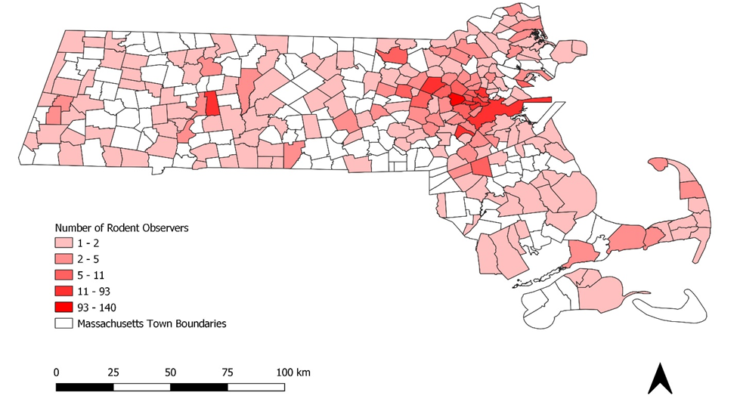
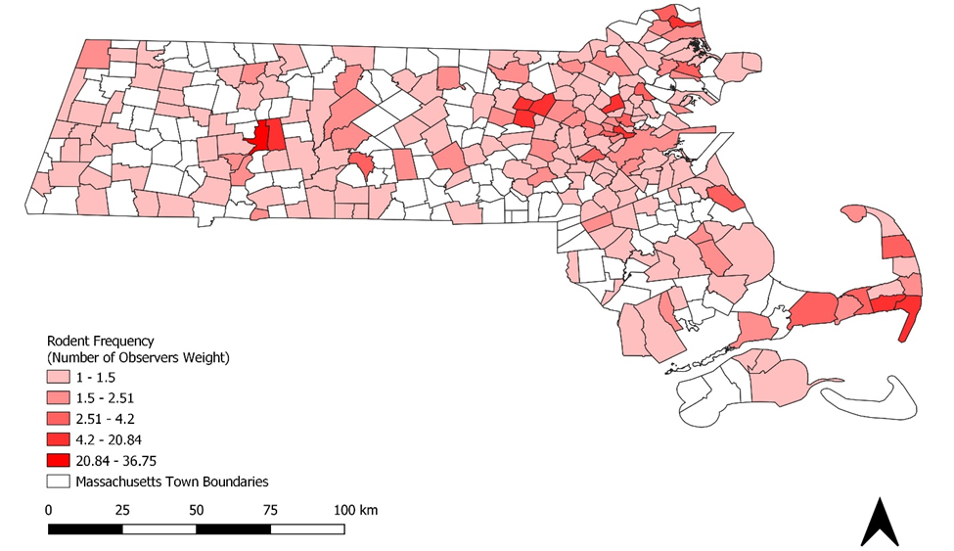
Summarizing and Standardizing the Data
How do we want to summarize/standardize?
(Right) Rodent frequency totaled from 2013-2018 and weighted by the number of observers per town. (Left) Total number of unique rodent observers per town.

Slide 18
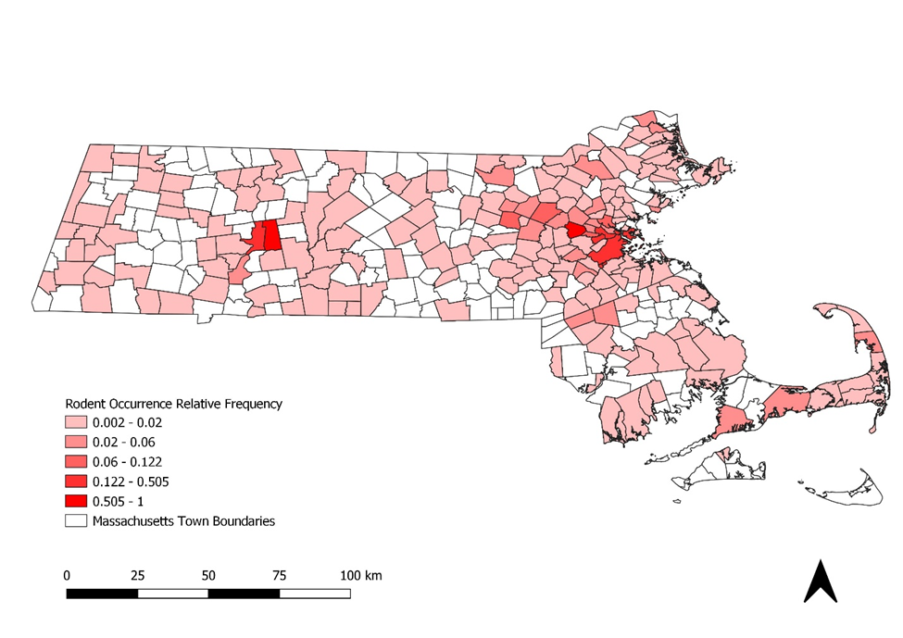
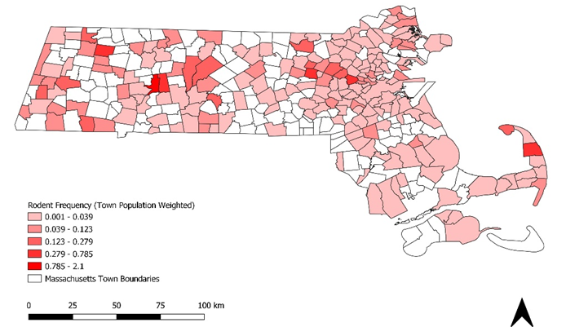
Summarizing and Standardizing the Data
How do we want to summarize/standardize?
Adding weights adjust for detection probability.
(Right) Rodent frequency totaled from 2013-2018 and weighted by the town’s human population size. (Left) Total number of rodent occurrences per town.

Slide 19
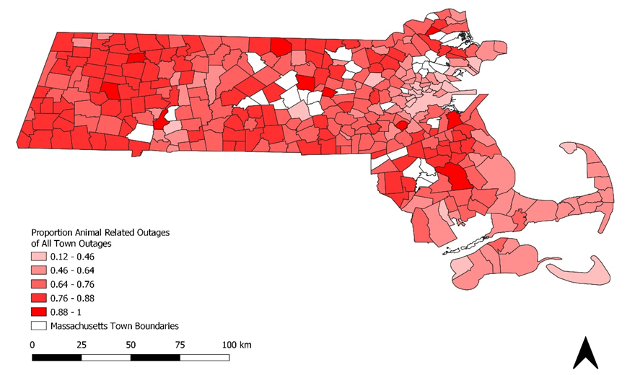
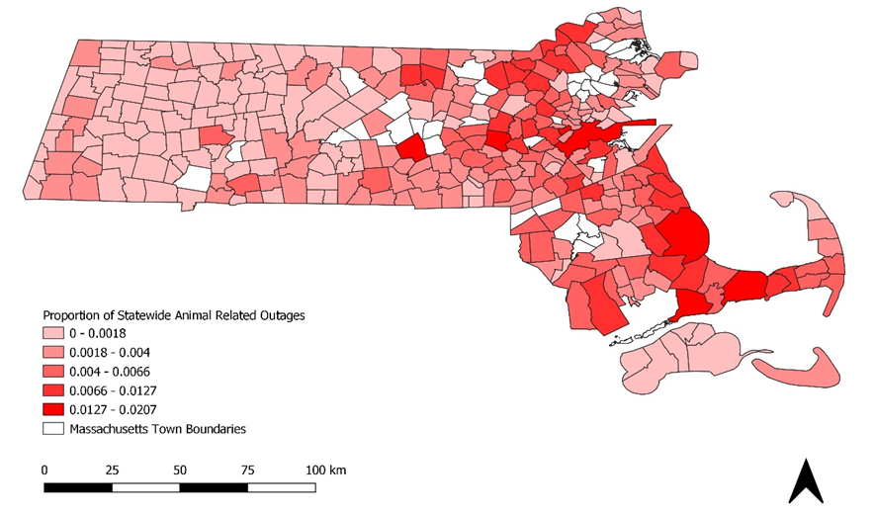
Summarizing and Standardizing the Data
How do we want to summarize/standardize?
Comparing two measures of outage reports. (Left) The proportion of each town’s outages that are animal related. (Right) The proportion of the total number of animal related outages statewide contained in each town.

Slide 20
Variables to Consider in Analysis
Season, time of day, weather
Can create “events” of certain weather combinations (ex, high wind, high temperatures, and heavy precipitation indicative of less squirrel activity)
Nocturnal vs Diurnal species
Breeding and nesting seasons create more foraging activity
Land use type (wetlands and agricultural fields are food rich areas for birds)
Urban-rural gradient
Vegetation density/proximity

